Slide 1
Promoting Intelligence!!
Vijaya Advertising
Offline Project Management Console
With All Features

Slide 2
Phases
Phase 1
All Create Record Forms
Enter Attendance
Generate Stock Bills
Generate Stock / PI / Invoice to Client
Phase 2
ID Card & V. Card Format
All View Records
Phase 3
Report Generation
Need the Entire Project Completed In 25 Days.

Slide 3
On Blank Index Page With Heading – Will Edit Later - NEW
On First Time Login / Open – All Will Be Blank
To Create First Client
Create Client Link Here – Other Links will be common in all sections as per table below
You Can Choose Any Design Vendor Name and Image should be clear

Slide 4
Create Client - NEW
Name of the Client - Required
Upload Client Company Logo - Required
Head Office – Not Required
Branch Address – Not Required
Contact Person 1 to 5 Persons (+ To Add In Future
Mobile No. (Same as Above)

Slide 5
Index Page Layout After Creating 1st Client - NEW
Link to View / Edit Client Details when I click on Logo
HUL
HomE 2 HomE
To Create More Vendors In Future
Use any Design Here…..But Should Have Option to Show Image

Slide 6
After Creating 2nd Client and this format will continue - NEW
Link to View / Edit Client Details when I click on Logo
Polycab India
Limited
HUL
HomE 2 HomE
To Create More Vendors In Future

Slide 7
On the Next Page - NEW
After Entering the Client, List of Vendors Side By Side – Same Like Create Client & This also will Start With Bank Page
To Create First Vendor
Link to Create Vendor – Other Links will be common in all sections as per table bellow
Any Other Creation & Data Entry Will start after choosing the Vendor.

Slide 8
Create Vendor - NEW
Form Contents:
Vendor Name – Only Once
Vendor Head Address – Only Once
Vendor Logo Upload
Vendor Signature Upload
Vendor Work / Branch Address (+ Symbol to Add another Empty Line to Add More Locations at the same time or in future
Contact Person 1 to 5 Persons May Add later or at the same Time
Designation
Email ID For All Above
Mobile For All Above
Name of the Account
Account No.
Bank Name
Branch
IFSC Code

Slide 9
On the Next Page - NEW
List of Vendors Side By Side – Same Like Above will Start With Bank Page – Image Optional
Brand Events
Vijaya Advertising
Any Other
Any Other Creation & Data Entry Will start after choosing the Vendor.

Slide 10
Layout Page - NEW
List of Vendors Side By Side – Same Like Above will Start With Bank Page – Image Optional
Brand Events
Click Here To Enter Data
All Create Forms To Be displayed Here and
Only or Error Page if Field Not Available while entering Data, Back Button
To Be Linked to this Page.
Link to Create Vendor – Other Links will be common in all sections as per table bellow
Any Other Creation & Data Entry Will start after choosing the Vendor.

Slide 11
Create Sub Vendor - NEW
List of Sub Vendors Side By Side – Same Like Above will Start With Bank Page – Image Optional & Need Skip Option Here Sub Vendor Creation is Not Mandatory.
Vijaya Advertisng
Click Here To Enter Data
All Create Forms To Be displayed Here and
Only or Error Page if Field Not Available while entering Data, Back Button
To Be Linked to this Page.
Link to Create Vendor – Other Links will be common in all sections as per table bellow
Any Other Creation & Data Entry Will start after choosing the Vendor.

Slide 12
Create Sub Vendor - NEW
Form Contents:
Sub Vendor Name – Only Once
Sub Vendor Head Address – Only Once
Sub Vendor Work / Branch Address (+ Symbol to Add another Empty Line to Add More Locations at the same time or in future
Contact Person 1 to 5 Persons May Add later or at the same Time
Designation
Email ID For All Above
Mobile For All Above
Name of the Account
Account No.
Bank Name
Branch
IFSC Code

Slide 13
On the Next Page - NEW
Vijaya Advertising
Forms
Create Team
Create Employee
Create Distributor
Create Retailer
Create Products List
Create ID Card
Create V. Card
Choose from Create Forms or Click Here to Enter Data
Link to Create Forms – Other Links will be common in all sections as per table bellow
Any Other Creation & Data Entry Will start after choosing the Vendor.

Slide 14
All Forms In Detail -OLD
Create Team
1
Brand
Team Code
2
Location – Enter Manually
Address
3
Supervisor
Mobile No.
4
Vendor Drop Down
4
CRT Date Calendar Format Store In Database to Choose when Creating Employee
Vendor Head Office
5
Team Logo Upload - Optional

Slide 15
Create Employee Part 1 –All in 1 Page - MODIFY
Promoter / Employee Code Choose From Left Side Drop Down and In the side empty field to enter code
4
Location – Auto Copy from Database – Create Team - Need not show in Form
Team Name – Drop Down Created in Create Team
3
State
City
2
Address – Complete with Pin Code
Employee Name
1
Work Mobile Number
5
Supervisor – Auto Copy Or Need not show in Form
Supervisor Mobile Number - Auto Copy Or Need not show in Form
6
CRT Date OR – While Preparing Generate Attendance Record need to calculate this into briefing cost
Field Training Date – Any One Mandatory

Slide 16
All Forms In Detail - MODIFY
Create Employee – Part 2
KYC Document Type
1
KYC Document Number
2
Name on The Account
Account No.
3
Bank Name
Branch
2
Wages
Cycle – Drop Down – Daily / Monthly

Slide 17
All Forms In Detail - MODIFY
Create Employee – Part 3
1
IFSC Code
Father / Husband Name
2
Blood Group
Emergency No.
3
Upload ID Proof – Not Mandatory
Upload Address Proof Not Mandatory
Upload Photo Not Mandatory
4
Link To Generate ID Card
Link To Generate V. Card

Slide 18
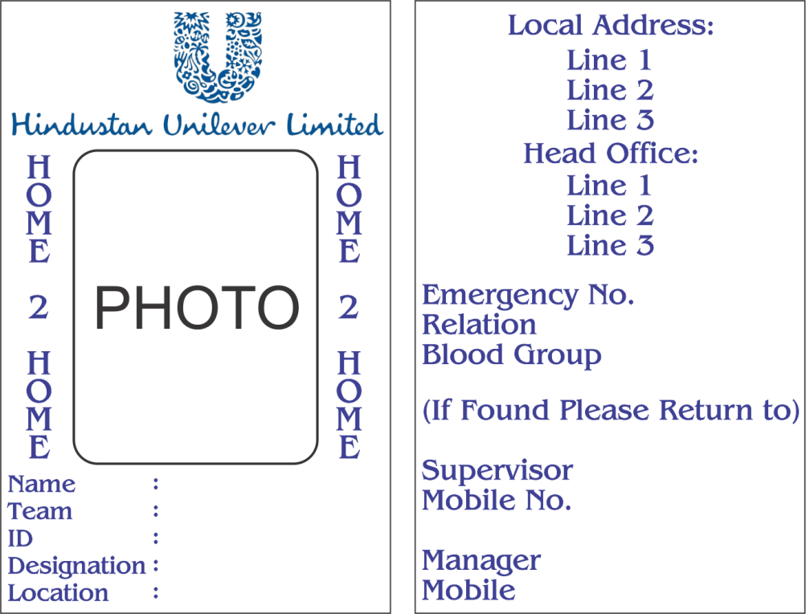
ID Card Format - NEW All Fields in this will Be Generated based on the data in the database Table.

Slide 19
V Card Format - NEW
Will Prepare and Give you later

Slide 20
Create Distributor MODIFY
1
Distributor Name
Address
2
City
Pin Code
3
Phone No.
4
GSTIN No.
RS Pan No.
5
Sales Man Name
Beat Name
6
Reg-State Code
Ref. No.
7
Vehicle Name

Slide 21
Create Retailer - MODIFY
1
Retailer Name
Address 1
3
Phone No.
4
Retailer Pan No.
4
Reg-State Code
GSTIN No.
5
GST Type - Mandatory

Slide 22
Create Products List - MODIFY
1
Select from Goods / Service – Not to be show in Invoice / Bill
3
MRP
4
Base Rate
UPC
2
Item Name
HSN Code / SAC Code – Auto Select based on the above selection
GST %
Discount %

Slide 23
Extra Links - NEW
Extra Links in View Employee Record
Generate ID Card
Generate V. Card

Slide 24
Layout After Entering The Vendor Page Common For all Vendors - NEW
Data Entry & Reports
Enter Attendance
Enter Income – From Client / Vendor
Enter Recharge & Expenses Team Wise
Generate Stock Bill - PDF
Generate Stock / Proforma Invoice / Invoice to Vendor / Client
View Teams
View Employee Record
View Supervisor Record
View Attendance – Date Filter Required – With Month & Year Drop Down – Date from & To Not Mandatory.
Error Reporting If Fields Not Created – With Back Button & Redirect to Slide 12

Slide 25
Enter Attendance - MODIFY
1
Select Team
2
List of Promoters with Select Promoters Checkbox & Image Above
3
Submit Button – Show Next Date even if Image Not Present Check Box in all Pages to chose if Sunday or Holiday (Sometime we work even on Sunday and holiday)
+ Back Button to Slide 24
Select Date (Select Month & Year Only) Date shall be entered Manually
Empty Form and Image Above & Enter Data

Slide 26
Enter Income / Material Received From Client / Vendor - NEW
1
Date – Select from Calendar or Enter Manually - Select after Received Type or Date Your Choice
2
Select Amount / Material Received - Select after Date or Material Received First Your Choice
3
If Amount – Empty field to Fill Amount
If Material – 3 Fields with + Option to Add more materials
4
1: Material Name
3 Qty
4 Cost Not Mandatory
2 Material Description – Not Mandatory

Slide 27
Enter Recharge & Transfer Details - NEW
1
Recharge / Transfer
2
Promoter ID – Select From Drop Down
Date – Select from Calendar or Enter Manually
Team – Select From Drop Down – If Recharge Selected
Enter Recharge Amount
4
If Transfer Amount
Team Name – Select from Drop Down
Enter Amount – To Be Added in Amount Transferred when Generating Supervisor Attendance Report
Purpose – Manually Entry
If Recharge – Go to Sr. No. 2 else One More Selection – Amount / Material
Display Mobile No.
3
5
If Material Selected
Item Name
Item Description
Qty
Cost – Not Mandatory

Slide 28
Generate Stock Bills – MODIFY (Page Width Only)
1
Invoice Number
Date
2
Select Product
Enter Qty
(In Cases & Pcs) Format
4
Bill will need to get auto calculated and will fit in the given layout based on the above selection criteria Eg. 1 Format for Distributor 1 and Second Format for Distributor 2 Bill to Print in PDF
3
Select Distributor
Select Retailer

Slide 29
Generate Stock / Proform Invoice / Invoice to Client / Vendor (MODIFY PAGE WIDTH ONLY)
3
Enter Invoice Number
Select Date – Select from Calendar or enter manually
4
Select Product
Enter Qty
(In Cases & Pcs) Format
5
Select GST / IGST – Auto Select Based on Retailer
Enter Amount (If No Amount is entered then auto calculate as per stock bill calculation
2
Select Retailer
Address: - Auto Copy in Bill from Database – Not to show in field
Enter % (If GST, 2 Fields with Names : SGST & CGST & If IFGST only 1 Field IGST)
1
Select – From Drop Down – Options
Stock Invoice
Proforma Invoice
Invoice

Slide 30
View Teams - NEW
1
Show List of All Teams In the Left Side
On Click Show Details on the Right Side
2
With Edit Button

Slide 31
View Employee Record NEW
1
Enter Promoter ID – Display & Export option to PDF Including ID And Address Proof & Photo and If CSV then All Details except ID Address Proof and Photo. (Individual Promoter)
OR
2
Select Team – Display And Export Option for All Promoters in the List to PDF Including ID And Address Proof & Photo and If CSV then All Details except ID Address Proof and Photo.

Slide 32
View Supervisor Record NEW
1
Supervisor Name
2
Location
Supervisor Mobile No.
Team Name

Slide 33
View Recorded Attendance Display with Option to Export / Print to PDF to Supervisor / Vendor - NEW
1
View Attendance
Generate Attendance Report

Slide 34
View Recorded Attendance Display with Option to Export / Print to PDF to Supervisor Image in the Next Slide - NEW
1
Team Name - Mandatory (Option to Show for All teams)
From Date and To Date
3
OR Select Month and Year to Display Attendance Record
After Submission in the next page, display report with export / Print to PDF Option.
– Any One Mandatory
2
Show All Amounts Transferred to the Team in the Month – Get From Database
Show only selected Material Sent to the team in the Month – Get From Database
In the Next Page, All Records entered shall be shown with total salary, Material List, Amount Transferred Recharge Details + 1 Empty Fields against each Promoter Line Named Deductions which I will enter Manually
2 More Fields Named Expense Name, & Amount with + Option to add more items and submit button

Slide 35
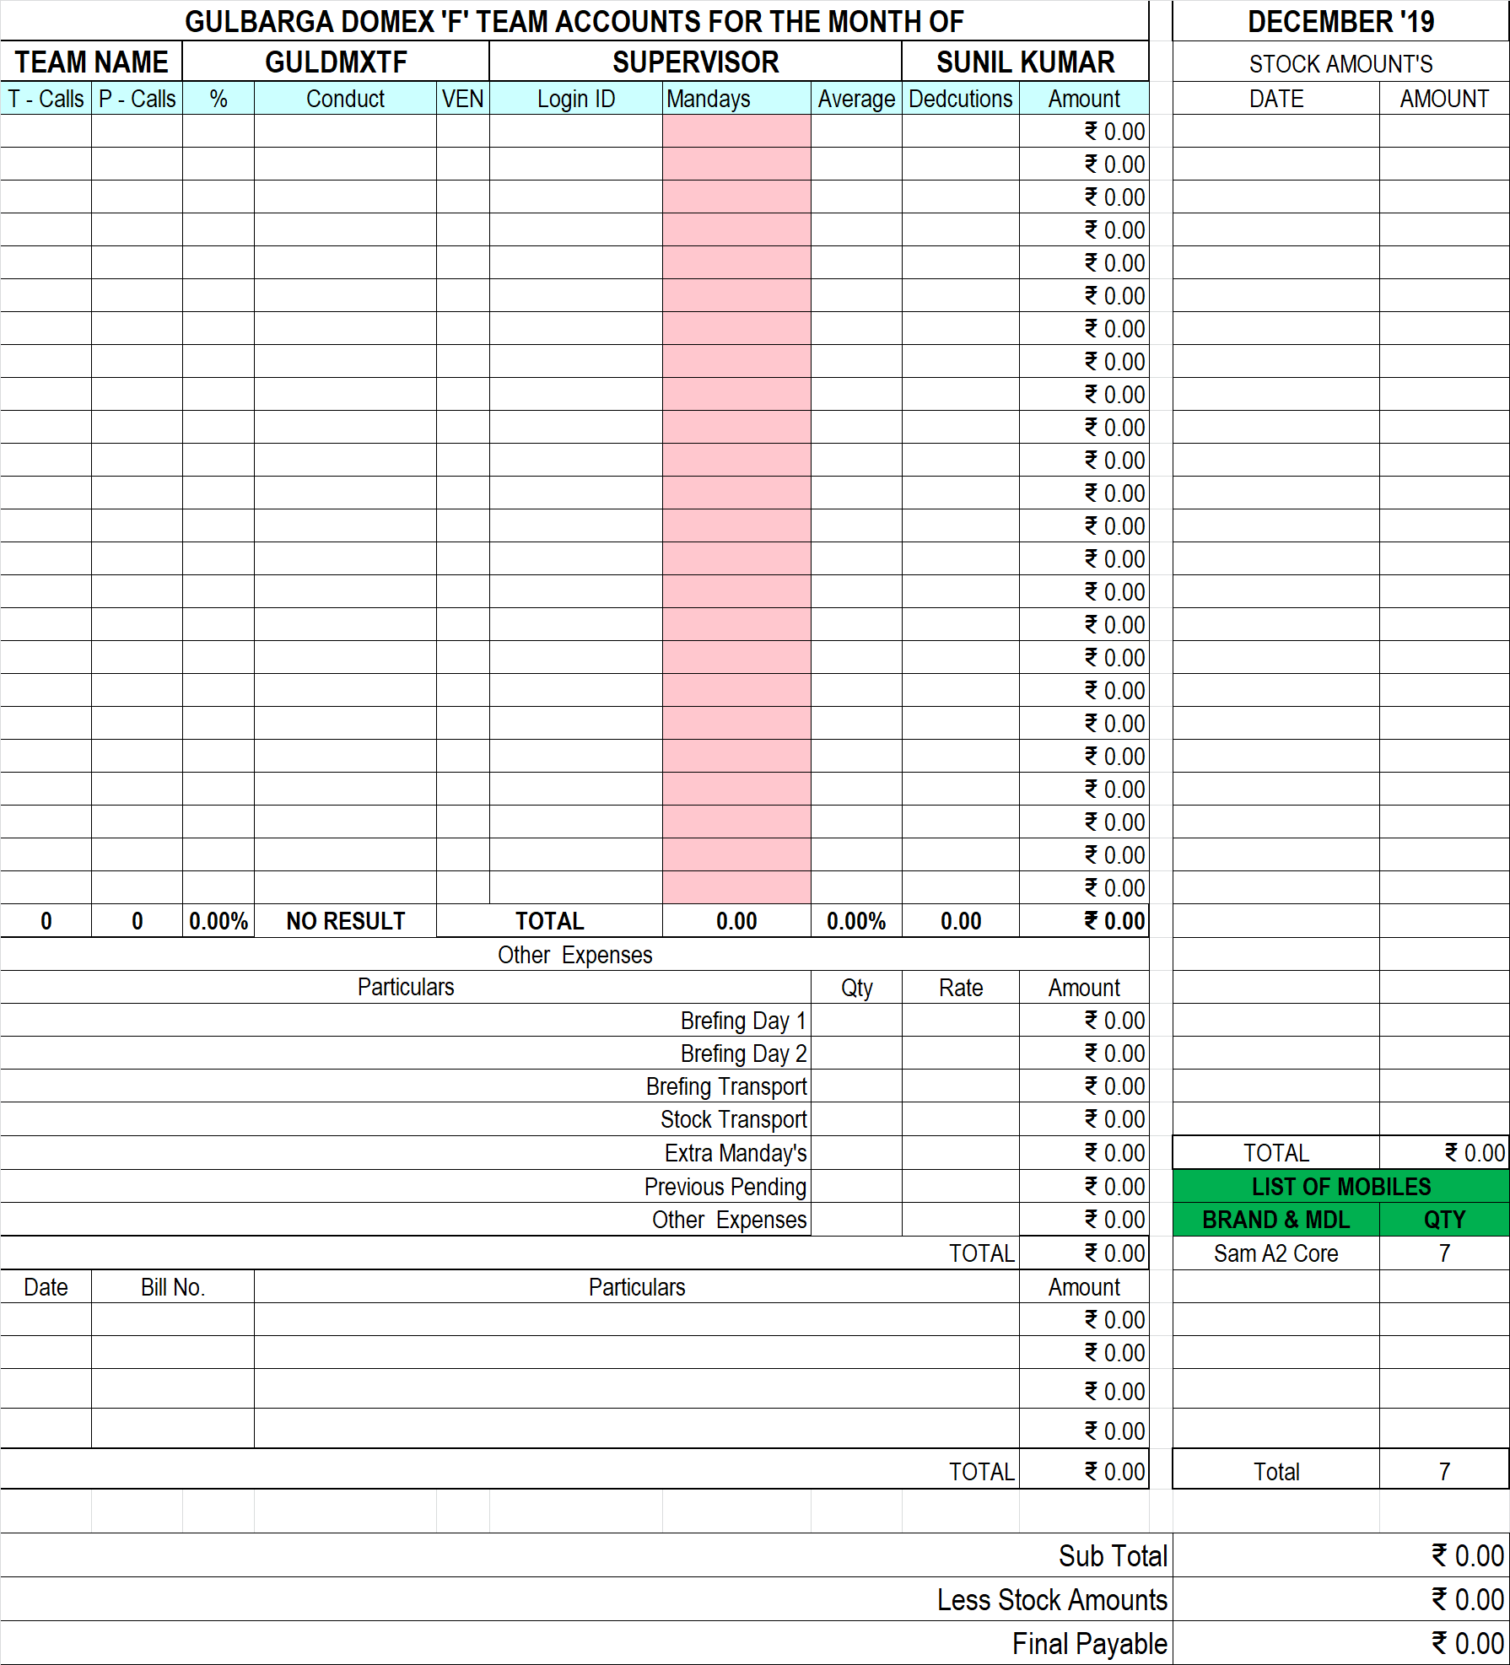
E X P O R T E D
D A T A
-
NEW
Recharge Total & Supplier Commission to Be Added. I will inform you once you are on this page. Call Me

Slide 36
For Client / Vendor - NEW
1
All Teams Default Selection with Individual Generated Manday’s
In the Next Page Display the Following
2
Total Mandays – Team Wise – Image in the Next Slide
3
List of Mobiles
Income as per this format:
Product Select from Drop Down
No. of PCS – Manual Entry
Income – From Database
Recharge Details – From Database
List of Mobiles – (Display Type) Model No. & Qty
Amount Received – From Data Base

Slide 37
For Client / Vendor - NEW
Other Deductions – Over All Deductions if Any or else Leave Blank
6
Blank 2 Columns against each team for Adding Deductions or Leave Blank – Not Mandatory – But if Added then Deduct from Total Salary
5
Add Briefing Details
4
Briefing Day 1 – No. of CRT’s, NOP, Cost, Projector – Yes/No (If Yes Then Cost X Total NOP + 1000/-) - (If No then only Cost X No. of Promoters) + Option to Add More Briefing Expenses
Column 1: Amount
Column 2: Reason

Slide 38
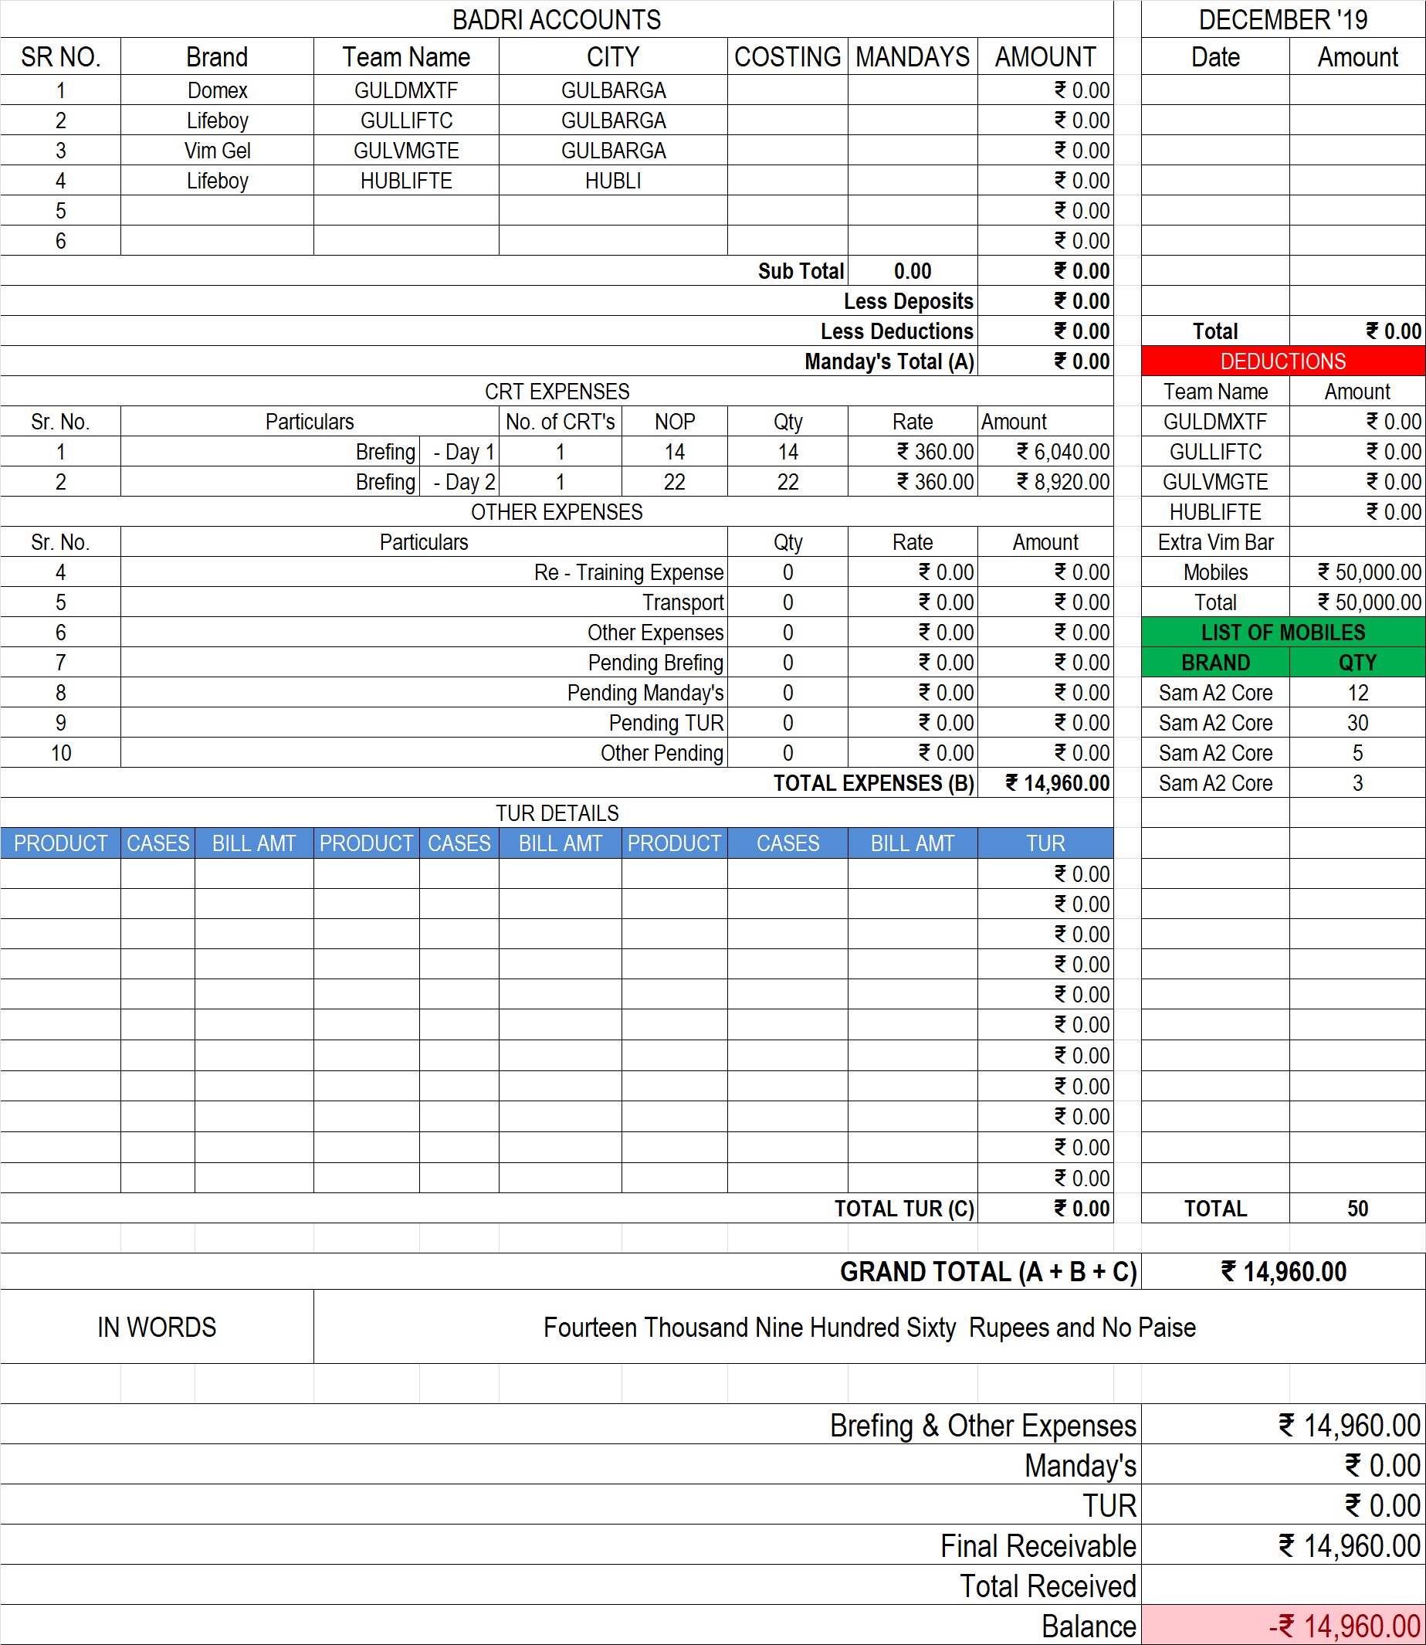
E X P O R T E D
D A T A
-
NEW

Slide 39
Stock Bills Format
Please check Attached PDF File – Format Almost Ready
Vendor Stock Bills Format
Please check Attached PDF File – Format Almost Ready
Proforma Invoice
Please check Attached PDF File – Format Ready
Invoice
Please check Attached PDF File – Format Ready

Slide 40
The END…..!

